Slide 1
SUNRISE GENERAL EMPLOYEES RETIREMENT PLAN RETIREMENT WORKSHOP
April 18, 2022
BY: STUART A. KAUFMAN, ESQ. KLAUSNER, KAUFMAN, JENSEN & LEVINSON, P.A.

Slide 2
BE SURE TO ASK QUESTIONS!!!
…Remember there is no such thing as a dumb question

Slide 3
SUMMARY OF PLAN PROVISIONS
KEY TERMS
Defined Benefit
Vesting
Average Final Compensation
Normal Retirement Date
Normal Retirement Benefit
Normal Form of Payment
Optional Forms of Payment
DROP

Slide 4
BACKGROUND ABOUT THE PLAN
The Plan is administered by a seven member Board of Trustees:
Three Trustees are active employees & members of the Plan who are elected by active Plan members;
Three Trustees are appointed by City Commission & must be members of the Plan;
Seventh Trustee is selected by a majority vote of the other six Trustees & must also be a Plan member.

Slide 5
ROLE OF THE TRUSTEES
The Board’s duties are set forth in the Pension Plan and include: investing and diversifying plan assets, processing retirement applications, reviewing disability applications and overseeing the administration of the plan.
The Board does not have the ability to create new pension benefits. The pension plan can only be amended by the City Commission.
Benefits are negotiated by the union and the City through the collective bargaining process.

Slide 6
ROLE OF THE TRUSTEES CON’T
The Board also employs the third party professionals who work for the Board, including a third party administrator, the investment managers, investment consultant, plan attorney, auditor, and actuary.
The third party administrator assists the Board in fulfilling their administrative responsibilities.
Plan assets are invested by the investment managers, whose performance is graded by the independent investment consultant.
The actuary calculates the required annual contributions into the plan to maintain its financial health. The actuary prepares “impact statements” prior to the passage of new benefits.

Slide 7
PLAN BACKGROUND
WHAT TYPE OF PLAN IS THIS?
DEFINED BENEFIT PLAN
If you complete the required number of years of service, upon reaching normal retirement age, you
will be benefit
eligible to receive a guaranteed pension based on a percentage of your salary
multiplied by the number of years that you have been a member of the Plan.

Slide 8
PLAN BACKGROUND CON’T
Plan is
not a Defined
Contribution Plan
Plan is not a 401(k) plan
Members don’t have a right to underlying pension assets (only monthly pension checks)
Under Florida law, the City is ultimately responsible for making certain that the Plan is actuarially sound
Members pension
cannot receive monies prior to
retirement or separation from service
Can’t borrow against your pension assets
Can’t assign your pension rights to another

Slide 9
VESTING
Need the minimum years of credited service to vest, which is based upon your Tier. For specific information on vesting eligibility please refer to page 12 of the Summary Plan Description.
If you separate from service prior to vesting, you are only entitled to a refund of YOUR contributions.
You are only eligible for a pension from the City if you have reached the minimum number of years required to vest. In addition to the required years of service, you also need to meet the age requirement.
If you are close to vesting in the pension, you should consider staying employed to obtain your minimum years of credited service.

Slide 10
AVERAGE FINAL COMPENSATION
For most employees, the Average Final Compensation is the average salary of your 3 best consecutive earning years.
Salary includes up to 300 hours of overtime for Tier 1 and Tier 2 employees. All overtime hours are excluded from salary of Tier 3 employees.
Salary excludes lump sum payouts of leave settlements upon separation from service, auto allowances, uniform allowances, mileage and travel reimbursement.

Slide 11
PENSION BENEFITS
The City has prepared a comprehensive Summary Plan Description (SPD) for the General Employees’ Retirement Plan.
The SPD is a plain language summary of your Pension benefits.
Pension benefits are summarized for all employees on page 12 of the Summary Plan Description.

Slide 12
MEMBER CONTRIBUTIONS TO THE PLAN
All members of the General Employees’ Retirement Plan are required to contribute a percentage of their salary to their future pension benefit. For specific information on your member contribution rate please refer to page 12 of the Summary Plan Description.
If a member separates service and requests a refund of their contributions, the member will no longer be eligible for a pension from the City.

Slide 13
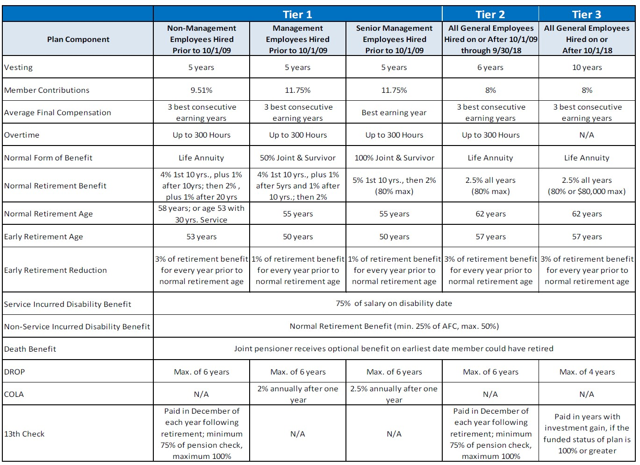

Slide 14
NORMAL FORM OF PAYMENT
LIFE ANNUITY (highest monthly benefit)
Monthly payment for your entire life
At death all benefits cease
No survivorship protection
POP-UP not applicable
In the event of early death, employee contributions will be paid to beneficiary

Slide 15
OPTIONAL FORMS OF PAYMENT
Joint and Survivor Annuity
100% (100% of pension benefit continues to joint annuitant after member’s death)
50% (50% of pension benefit continues to joint annuitant after member’s death)
Joint and Survivor Annuity is an actuarially reduced benefit
POP-UP applies to Joint and Survivor Annuity, not to Life Annuity

Slide 16
POP-UP OPTION
Under the POP-UP option, the pension benefit of a member who has selected a joint and survivor benefit will be actuarially increased (POP- UP) upon the death of the annuitant.
A member selecting the POP-UP option pays for the cost of the POP-UP by receiving a slightly lower benefit, but receives POP-UP protection if the annuitant predeceases the member (benefit POPs up to a larger amount).

Slide 17
WHAT IS THE DROP
Deferred Retirement Option Plan (DROP) allows you to continue working while your pension check accumulates monthly on your behalf
Upon entering DROP you “retire” for pension purposes, but you continue working for the City
Monthly pension amount is “locked in” as of DROP date of entry
Pension benefit accrues each month and earns interest at the rate of 4% per year, compounded annually
Employee must separate employment no later than the end of the DROP

Slide 18
DROP CONTINUED
HOW LONG CAN I PARTICIPATE IN DROP?
Tier 1 and Tier 2 employees can DROP for a maximum 6 years
Tier 3 employees can DROP for a maximum of 4 years
Eligible employees may enter the DROP at any time between early or normal retirement age and the five-year anniversary of the earliest normal retirement age.
Participants don’t need to stay the full DROP period. Employees can leave earlier with 30 days notice to the City.
THE DECISION TO ENTER TH¹⁸ E DROP IS IRREVOCABLE!!

Slide 19
DROP CONTINUED
HOW IS DROP MONEY PAID OUT?
Can’t touch DROP money until you separate from service.
IRS: “Constructive Receipt”
DROP Money is paid out in a lump sum 30 days after leaving the City, which can have tax implications.
Employees can elect to roll over their DROP money to an IRA, 457, or another qualified plan.

Slide 20
DROP ADVANTAGES
Lump sum / “nest egg” upon separation
Head-start on retirement
Continue working and receive a paycheck, while DROP grows
Tax Deferred Growth at a fixed rate of return (4%)
Tax deferral continues if DROP funds are rolled over
Employee is no longer make employee contributions to plan

Slide 21
DROP DISADVANTAGES
Required to terminate employment at end of DROP
If family circumstances change employee might not want to terminate employment – REMEMBER a decision to enter the DROP is irrevocable
No disability benefits available once in the DROP since already retired
Don’t get additional years of service credits or higher earnings
Lower monthly pension than if had not entered the DROP
If union
negotiates a higher pension benefit, assume
enhancements would not apply to those in the DROP

Slide 22
ADDITIONAL INFORMATION
Seek financial advice from a professional
Think about tax consequences for all funds
Consider all options to defer tax implications until a later date
Consider an IRA or ROTH IRA
Consider an Education IRA or 529 College Saving Plan

Slide 23
ADDITIONAL INFORMATION
Consider participating in the City’s 457 Deferred Compensation plan
The 457 plan allows employees put pre-tax dollars away for retirement. Employee will access funds upon separation when they are likely in a lower tax bracket.
457 plan - Employees can contribute up to $19,500 annually
Consider 457 plan “catch-up” provision or pre-retirement option for 3 years prior to retirement

Slide 24
ADDITIONAL INFORMATION
Make a will! (inevitability of death and taxes)
Be sure to update your will!
Submit a beneficiary designation to the Board
Remember to update your designation form

Slide 25
ADDITIONAL INFORMATION
FORFEITURE is the loss of your pension benefit when you:
Commit a specified criminal offense
Florida Statute Section 112.3173
Theft example

Slide 26
CONFLICTS
The foregoing presentation has been designed to help answer some of your questions about how your Pension Plan is organized and managed.
The final authority on interpretation of the Plan is the actual legislation which created the Plan.
In the event of any conflict between this presentation and the City Code the provisions of the Pension Code control.

Slide 27
Questions?

Slide 28
Get to Know your Workplace Retirement Plan Benefits – 457(b) and ROTH IRA
Presenter: Augusto C. Gaymer
Retirement Plans Specialist E: agaymer@missionsq.org P: (202) 759-7096
56032-1121-W820
This presentation is the property of MissionSquare Retirement and may not be reproduced or redistributed in any manner without permission.
MissionSquare Retirement does not offer specific tax or legal advice. Please consult with your personal advisor for additional assistance prior to implementing any new tax or legal strategy.

Slide 29
MissionSquare Retirement
New brand, same mission-based, nonstock, nonprofit, financial services company
50 years of experience helping those who serve their communities build retirement security
Personalized Financial Wellness Center, including online tools and consultations with licensed professionals
Results-oriented retirement plans, education, investments, and advice delivered to
public employees
www.missionsq.org
2

Slide 30
Retirement Plans Specialist
MissionSquare Retirement
Your holistic financial overview
Your savings goals and objectives
Assistance from your Retirement Plans Specialist
3

Slide 31
Why are your Financial Goals Important to You?
MissionSquare Retirement
I don’t want to be a financial burden to my family as I grow older.
I want to stop working and do something I love.
I want to be able to pay for future medical expenses.
I want to help pay for my kids’ college education.
I want to feel secure about my finances in retirement.
Source: Morningstar, The Investor Success Project, Mining for Goals. How Behavioral Nudges Can Help Investors Discover More Meaningful Goals, 2019
4
4

Slide 32
Retirement Income Planning Process
MissionSquare Retirement
Use savings to bridge the gap
Estimate how much income you’ll need
Identify the gap
Consider major factors like inflation
Total income from Social
Security, pensions
5

Slide 33
How Much Will Retirement Cost?
MissionSquare Retirement
Replace between 75% and 90% of your pre-retirement income.
Pre-retirement annual income
Estimated annual retirement income
x 80% =
Some individuals will need more, some less. How much do you think you’ll need?
6

Slide 34
Future Retirement Income
MissionSquare Retirement
Pension and/or Social
Security benefits
From a holistic point of view, saving for retirement is about
Annuities
generating income for retirement.
Insurance cash value
IRAs
Personal investments, rental income
Workplace retirement plan(s)
Part-time work
7

Slide 35
We Help Your Money Help You Retire
8

Slide 36
Tax-Advantaged Savings Vehicles
MissionSquare Retirement
457(b) Plans — Pre-Tax Contributions
Defer up to $20,500 of compensation (2022)
457(b) Plan Employee Contribution Limits
Individuals age 50 or older can make additional catch-up contributions of $6,500 (2022)
$25,000
$6,500 $6,500
$19,500 $19,500
$6,500
$20,000
$20,500
Funds grow tax-deferred until withdrawn
$15,000
$10,000
$5,000
$0
Limited to investment options offered by plan
Distributions made prior to age 59½ (age 55 or 50 in some circumstances) are subject to taxes but not subject to a premature distribution penalty
2020
2021 2022
Additional catch-up contribution for employees age 50 and older
Normal contribution limit
9

Slide 37
Save More With Flexible Contributions
MissionSquare Retirement
2022 Contribution Limits — 457 Plan
$20,500
Normal contribution limit
$20,500
Pre-retirement catch up*
$41,000
or
$20,500
Normal contribution limit
$6,500
Age 50 or over (as of year-end)
$27,000
*During each of the three years prior to the year you reach your normal retirement age, as defined in the plan and based on extent to which maximum contributions not made in previous years.
Note: Pre-retirement and Age-50 Catch-up provisions cannot be combined in the same plan year
10

Slide 38
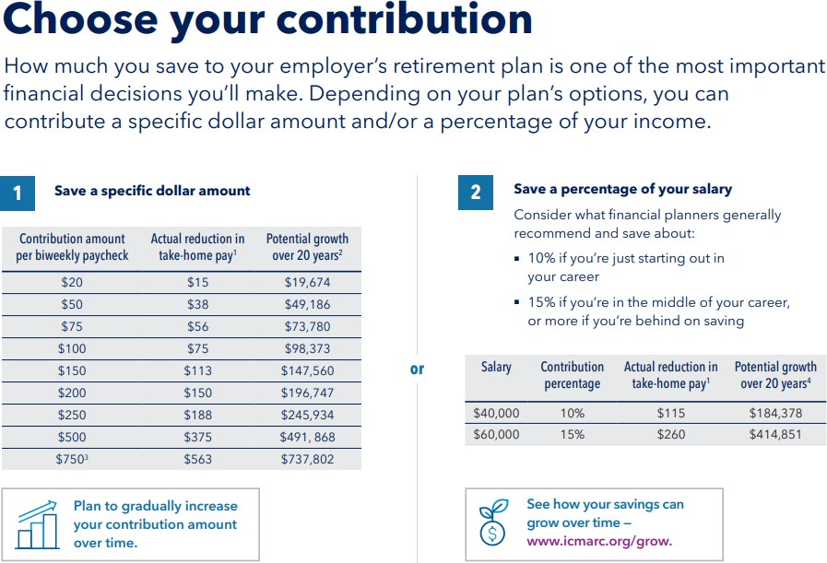
MissionSquare Retirement
Note all examples are rounded to the nearest whole dollar
Assumptions include: bi-weekly pre-tax contributions, a 25% marginal federal tax rate, and one witholding allowance. Reduction in take-home pay displayed is for first year only. Your actual tax situation, and thus the actual amount out of your paycheck, may be higher or lower.
Assumptions include: 6% effective average return, compunded biweekly.
11

Slide 39
Money Starts to Work for Itself
MissionSquare Retirement
Tax-deferral Growth
Can’t save $50 per pay period?
Start with
$20 or $10.
Every bit helps!
www.icmarc.org/ costofdelay
Account balance at age 65
$250,000
$200,000
$216,509
$150,000
$100,000
$109,137
$50,000
$50,170
$17,785
$0
Start at 25 Start at 35 Start at 45 Start at 55
For illustrative purposes only. Assumes $50 biweekly contributions and 6% average annual return.
12

Slide 40
Get a huge potential benefit from compounding interest
MissionSquare Retirement
You save $1,000 yearly from age 20-30
$168,515
AGE 20 25 30 35 40 45 50 55 60 65
$147,914
Your friend saves $1,000 yearly later from ages 30-65
Source: U.S. Department of Labor, “Savings Fitness: A Guide to Your Money and Your Financial Future”
13

Slide 41
We’re on the Journey With You
MissionSquare Retirement
To get started in your plan, enroll through the website
www.icmarc.org_{E}/_{S}e_{m}n_{i}r_{t}o_{h@}ll_{sunrisefl.gov}
or schedule an appointment with your Retirement Plans Specialist.
14
14

Slide 42
What’s a Payroll Roth IRA?
MissionSquare Retirement
Roth IRA — flexible savings vehicle with tax advantages
Payroll Roth IRA — automatic, convenient paycheck contributions
Paycheck Contributions
(after tax)
Tax-Deferred Investments
Tax-Free Withdrawals*
* Earnings may be withdrawn tax- and penalty-free if you have owned a Roth IRA for at least a five-year period, as defined by the IRS, and have a qualifying event, including age 59½, a first-time home purchase, disability or death. Otherwise, ordinary income and penalty taxes may apply. See IRS Publication 590.
15

Slide 43
Diversify your Contributions with Roth
MissionSquare Retirement
Roth contributions may make sense if you …
Expect to pay higher tax rate
when you withdraw
Want to diversify your tax situation — more flexibility when taking withdrawals
Want to pass on tax-free assets to heirs
16
16

Slide 44
Save More With Flexible Contributions
MissionSquare Retirement
How much can a $10,000 investment grow in 20 years?
$25 annual biweekly contribution increase
$272,805
Account value after 20 years
$83,325
Maintain your biweekly contributions (no increase)
www.icmarc.org/savingsboost | www.icmarc.org/grow
For illustrative purposes only. Assumes $10,000 account value, $50 biweekly contributions at age 40, and an effective annual return of 6%, compounded biweekly.
17

Slide 45
To Make Changes to Your Contributions
MissionSquare Retirement
Log into your account at
www.missionsquare.org
Speak with your Retirement Plans Specialist
Call MSQ Participant Services at (800) 669-7400
18
18

Slide 46
Investment fundamentals
MissionSquare Retirement
What is investing?
Speculating?
Saving?
Investing: A carefully planned and prepared approach to managing and accumulating money.
19
18

Slide 47
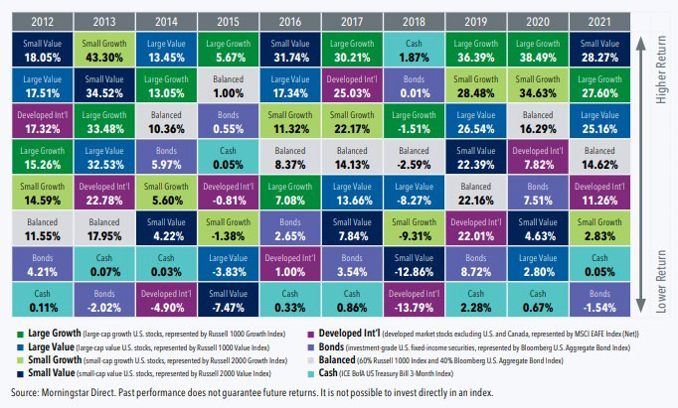
Beware of Market Predictions
MissionSquare Retirement
Do you see any predictable patterns?
20

Slide 48
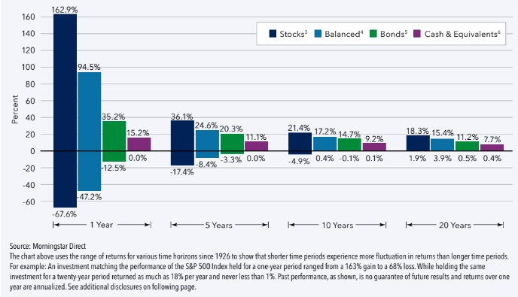
Keep a Long-Term Perspective
MissionSquare Retirement
Volatility vs. Return:^{1,2} Q1 1926-Q4 2021 Rolling Period Returns
(One Year Example: February 1945-January 1946, March 1945-February 1946, etc.)
21

Slide 49
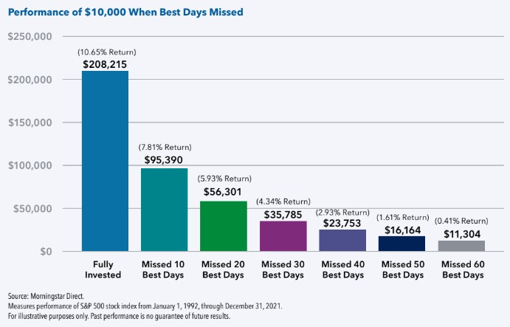
Choose Time in the Market Over Timing the Market
MissionSquare Retirement
After a downturn in the stock market, it’s understandable to feel discomfort. But if you move out of stocks as a result of these emotions, it can be challenging to get back in at the right time and you may risk missing the relatively big market gains that can occur after downturns.
22

Slide 50
Choose your Investing Approach
MissionSquare Retirement
I want to build my own portfolio
Stock, bond, stable value fund
I want a simple, yet diversified portfolio Target date fund
I want someone to do it for me
Account managed for you
23
23

Slide 51
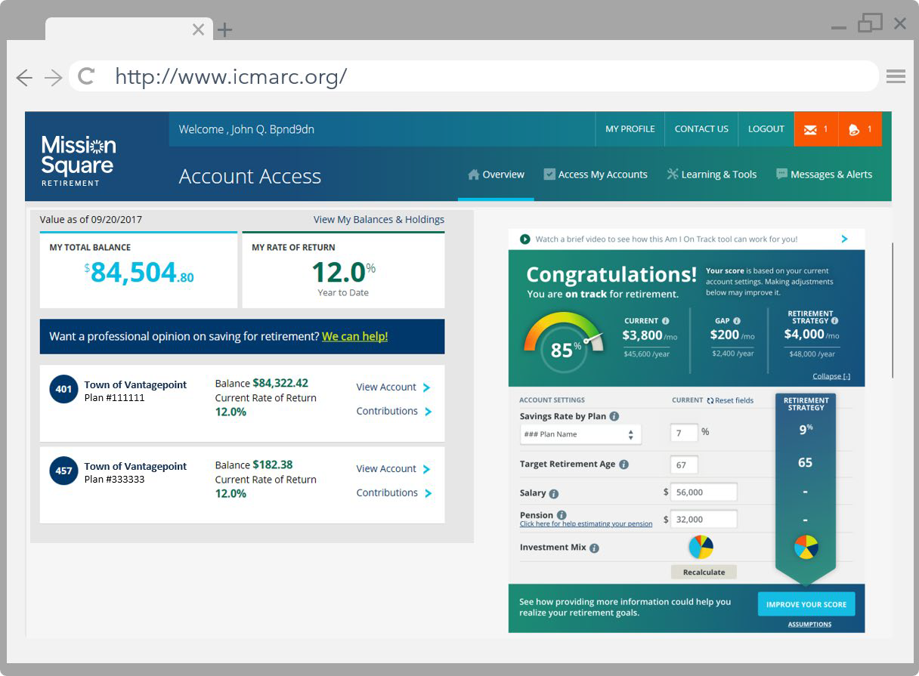
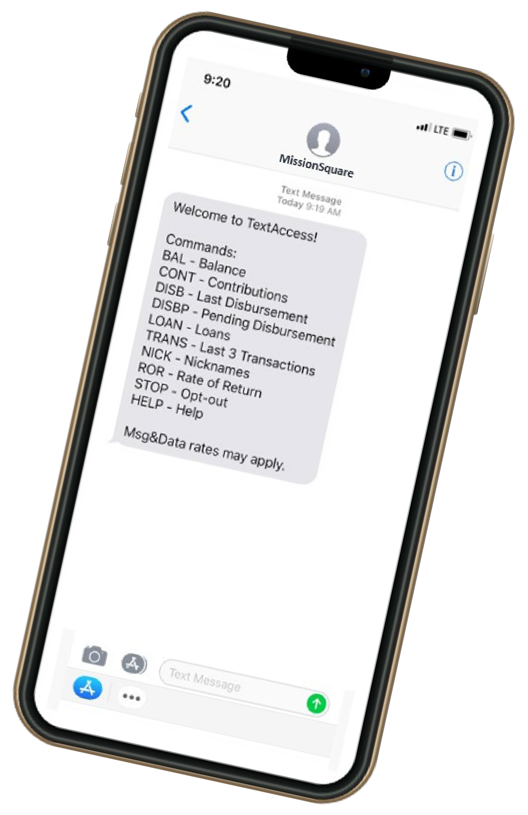
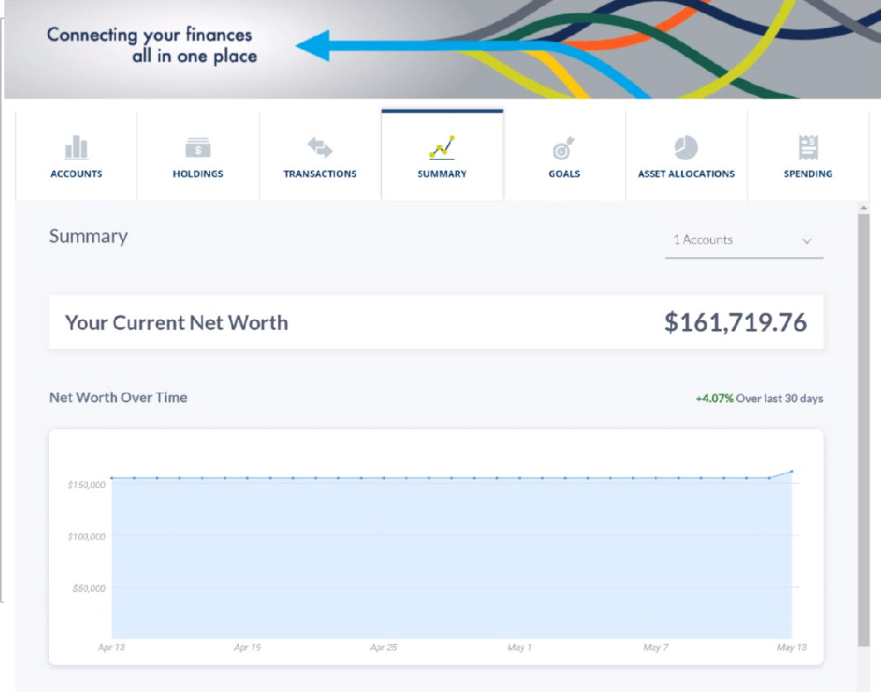
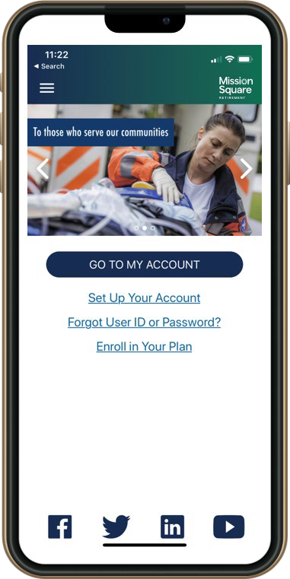
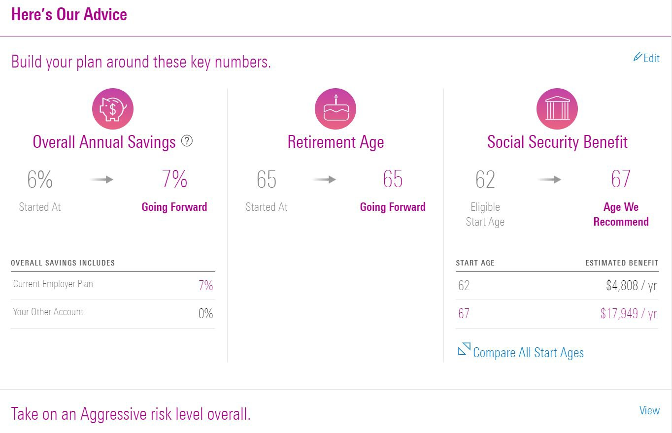
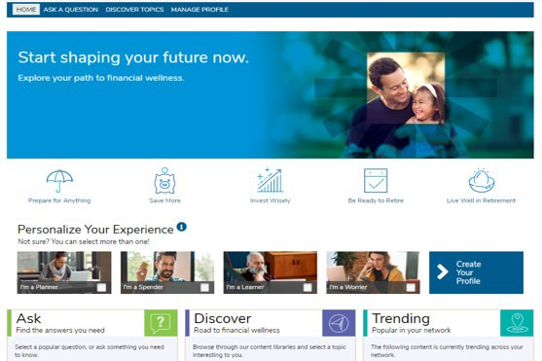
Investing and Educational Resources
MissionSquare Retirement
Account Access
 CLOSE
Manage your account on mobile
Text commands for balance, contributions, and more
Guided Pathways helps you to decide:
▪ How much to save for retirement
▪ How to invest your savings
▪ When you can retire
▪ How to take withdrawals from your savings
▪ When to start receiving Social Security benefits
* Guided Pathways® Advisory Services are an investment advice and analysis tools are offered to participants by MissionSquare Retirement, a federally registered investment adviser. Investment advice is the result of methodologies developed, maintained and overseen by the independent "Financial Expert" (as defined in the Department of Labor's Advisory Opinion 2001-09A) Morningstar Investment Management LLC, a registered investment adviser and subsidiary of Morningstar, Inc.
Morningstar Investment Management LLC is not affiliated with MissionSquare Retirement and its affiliates. The Morningstar name and logo are registered marks of Morningstar, Inc. For additional information on our Guided Pathways Advisory Services, please refer to our Form ADV Part 2A Brochure available at www.adviserinfo.sec.gov. Managed Accounts is a fee-based service.
Learn more about consolidating your retirement accounts
https://www.icmarc.org/accountaggregation video.html
▪ Manage your account online
▪ Am I On Track tool
▪ Learning Center
▪ Account Aggregation
http://www.missionsq.org
Financial wellness education tailored to your needs
▪ Plan for emergencies
▪ Take control of your finances and manage debt
▪ Understand budget management and saving
▪ Learn to invest responsibly
▪ Get access to personalized advice
Financial Wellness Center
Account Aggregation Guided Pathways® Services On the go with MSQ mobile
24

Slide 52
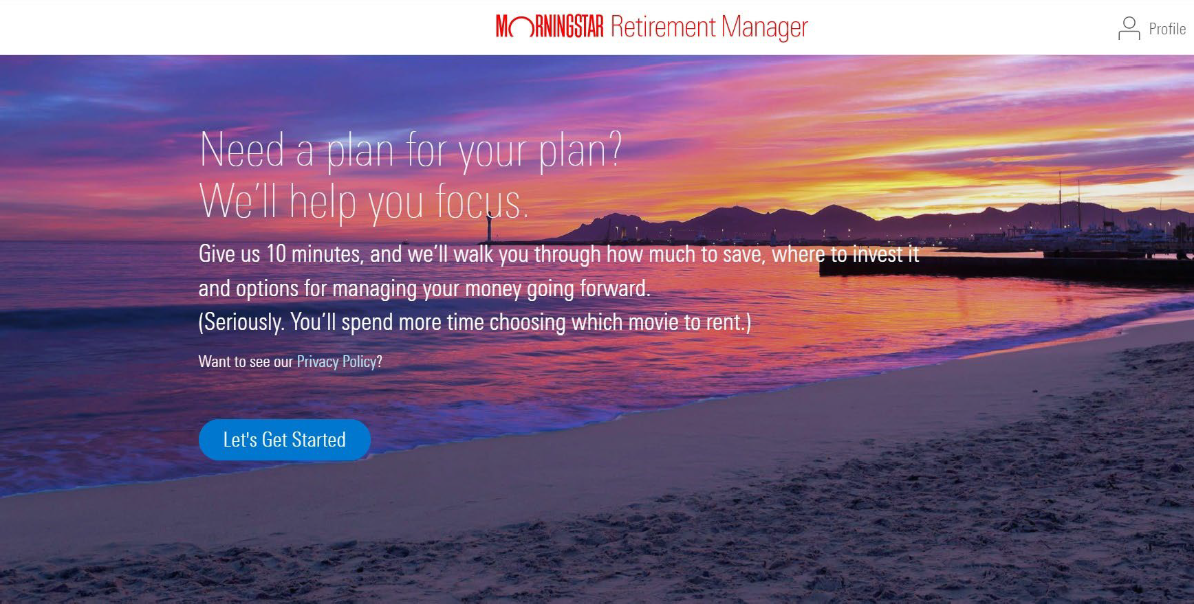
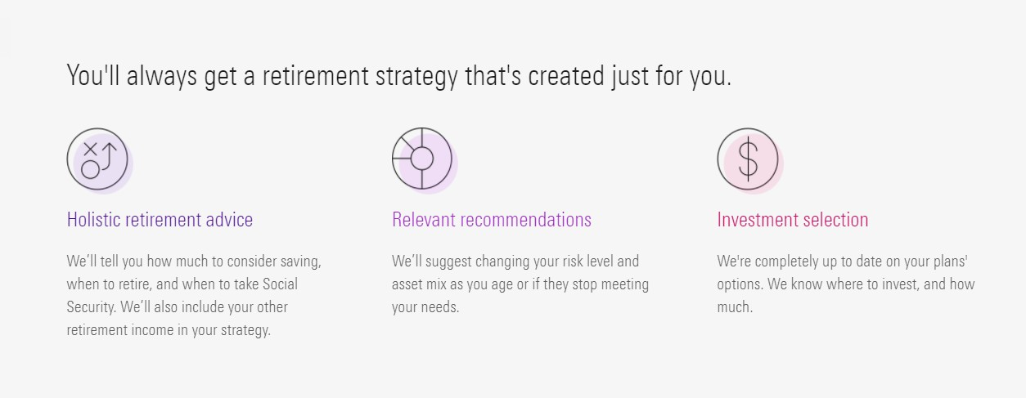
Making it Easier for you to Envision Retirement
MissionSquare Retirement
25

Slide 53
Guided Pathways® Advisory Services
MissionSquare Retirement
Financial consultant services
Balances of $50,000 or more
Free retirement readiness consultation with a MissionSquare financial consultant*
Enrollment in Managed Accounts through a financial consultant**
Easy access to webinars led by our CFP® professionals: www.icmarc.org/cfpwebinars
* Investment advice and analysis tools are offered to participants by MissionSquare Retirement, a federally registered investment adviser. Investment advice is the result of methodologies developed, maintained and overseen by the independent "Financial Expert" (as defined in the Department of Labor's Advisory Opinion 2001-09A) Morningstar Investment Management LLC, a registered investment adviser and subsidiary of Morningstar, Inc. Morningstar Investment Management LLC is not affiliated with MissionSquare Retirement and its affiliates. The Morningstar name and logo are registered marks of Morningstar, Inc. For additional information on our Guided Pathways Advisory Services, please refer to our Form ADV Part 2A Brochure available at www.adviserinfo.sec.gov.
** Guided Pathways Managed Accounts is a fee-based service.
26
26

Slide 54
CFP® Planning Services
MissionSquare Retirement
Financial planning services Balances of $100,000 or more Free CFP® professional consultations Social Security analyzer Free financial plans | Personal planning services Balances of $500,000 or more Dedicated CFP® professional Comprehensive financial plans with ongoing updates and services
Easy access to webinars led by our CFP® professionals: www.icmarc.org/cfpwebinars
27

Slide 55
MissionSquare Retirement
Simplify your Retirement Accounts
MissionSquare Retirement Account
IRA 401
457
28
28

Slide 56
Beneficiaries

Slide 57
Choose your Beneficiaries
MissionSquare Retirement
Your assets paid per your wishes
Avoid probate costs, delays
Avoid creditor claims
Loved ones can receive more tax benefits
Review periodically and after a major life event.
Married participants — Most 401 plans require your spouse to be the primary beneficiary for 100% of the account unless your spouse waives this right.
30

Slide 58
Enroll and Increase Your Savings
31

Slide 59
What would your future self say?
MissionSquare Retirement
9 out of 10 would have advised themselves to save more for their future
75% said they could have saved a little more over the years
Source: American Century Investments study, “Reflections in the Mirror”
32

Slide 60
Retirement Income Planning Road Map
MissionSquare Retirement
Enroll now
Invest
Financial wellness
Increase contributions
Retirement
Access
33

Slide 61
Thank You!
MissionSquare Retirement
Retirement Plans Specialist
Augusto C. Gaymer
(202) 759-7096
agaymer@missionsq.org
34
34

Slide 62
Questions?
MissionSquare Retirement
35
34

Slide 63
Disclosures
MissionSquare Retirement
The performance quoted represents past performance, is no guarantee of future results, and is annualized for periods greater than one year. Investment returns and principal value will fluctuate, so that an investor’s shares, when redeemed, may be worth more or less than their original cost. Current performance may be lower or higher than the performance shown. For current performance, contact MissionSquare Retirement by calling (800) 669-7400 or by visiting www.missionsq.org.
Indexes and peer groups are not available for direct investment. Indexes are unmanaged and do not reflect the costs of portfolio management or trading. A fund’s portfolio may differ significantly from the securities held in the indexes or by peers.
Stock performance is the S&P 500 Index which consists of 500 companies representing larger capitalization stocks traded in the U.S.
Balanced performance is the combination of 60% the S&P 500 Index and 40% a blended bond index (1926–1975 Long- Term Government Bonds, 1976–present Bloomberg U.S. Aggregate Bond Index).
Bond performance is a blend of the Long-Term Government Bond Index (1926–1975) and the Bloomberg U.S. Aggregate Bond Index (1976–present). The Bloomberg U.S. Aggregate Bond Index consists of investment-grade U.S. fixed income securities.
Cash & Equivalents (C&E) performance is the IA SBBI US 30 Day T-Bill Index.
36

